Slide 1
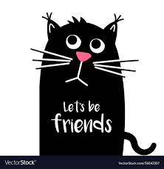
Instafriends
Where everyone is friends with EVERYONE

Slide 2
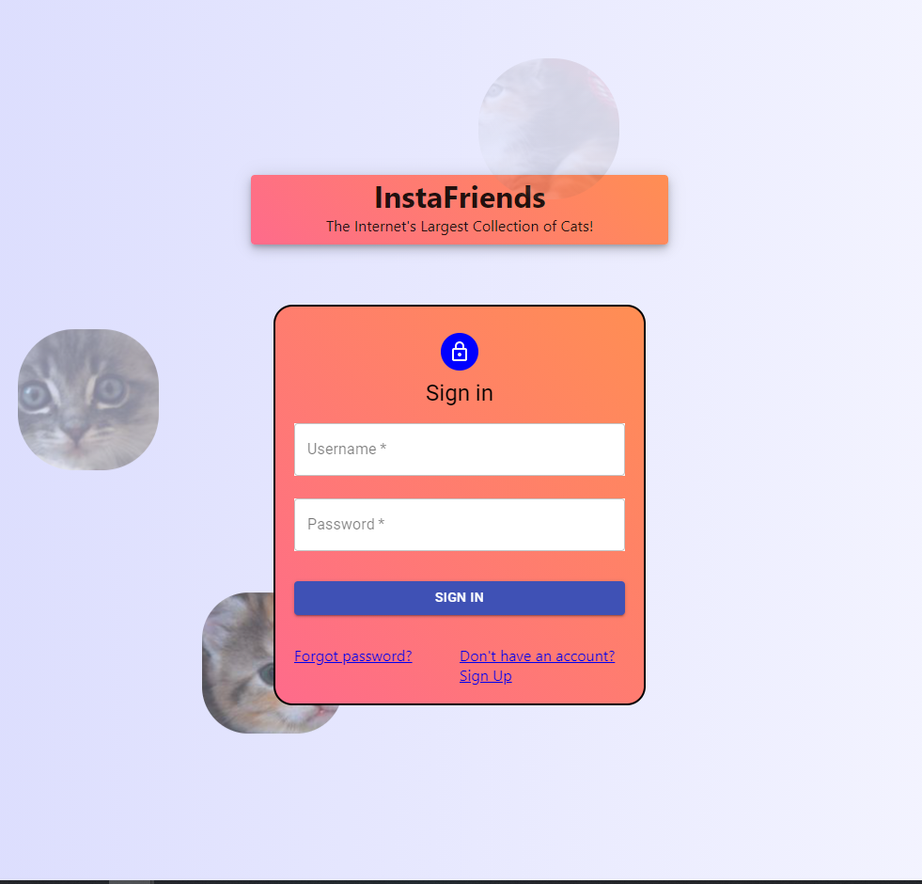
What is it?
A Social Networking App for People to Showcase their unconditional love for CATS!
Once Registered...
Users Are Be Able To >>>>>>>>>>>

Slide 3
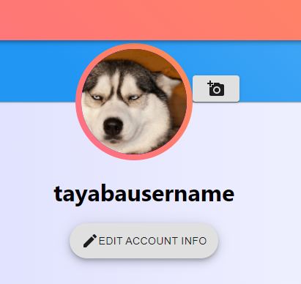
Upload a profile picture

Slide 4
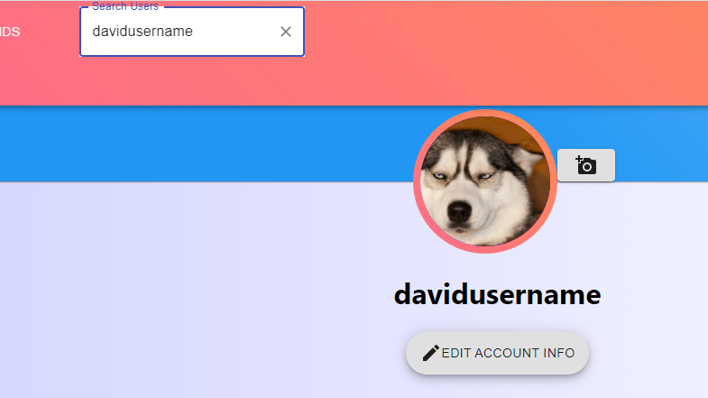
Search for other cat enthusiasts

Slide 5
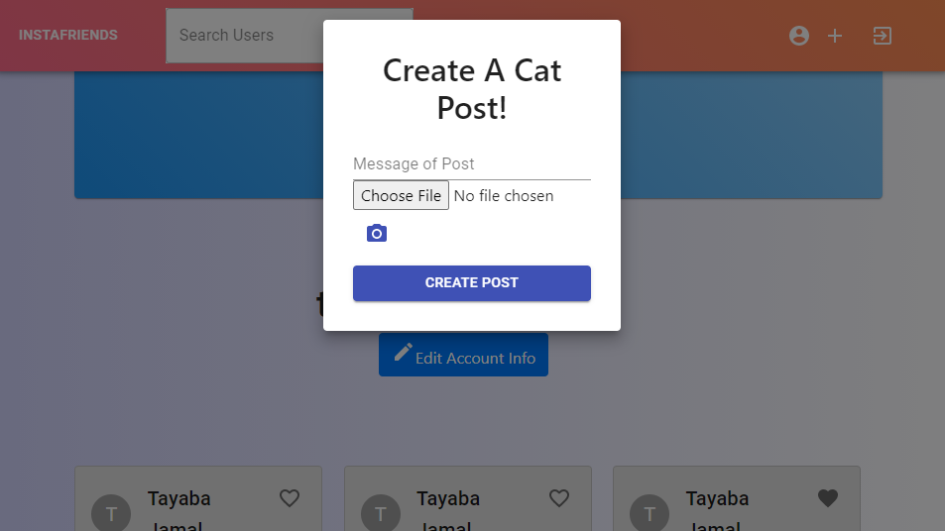
Post their own collections of cats

Slide 6
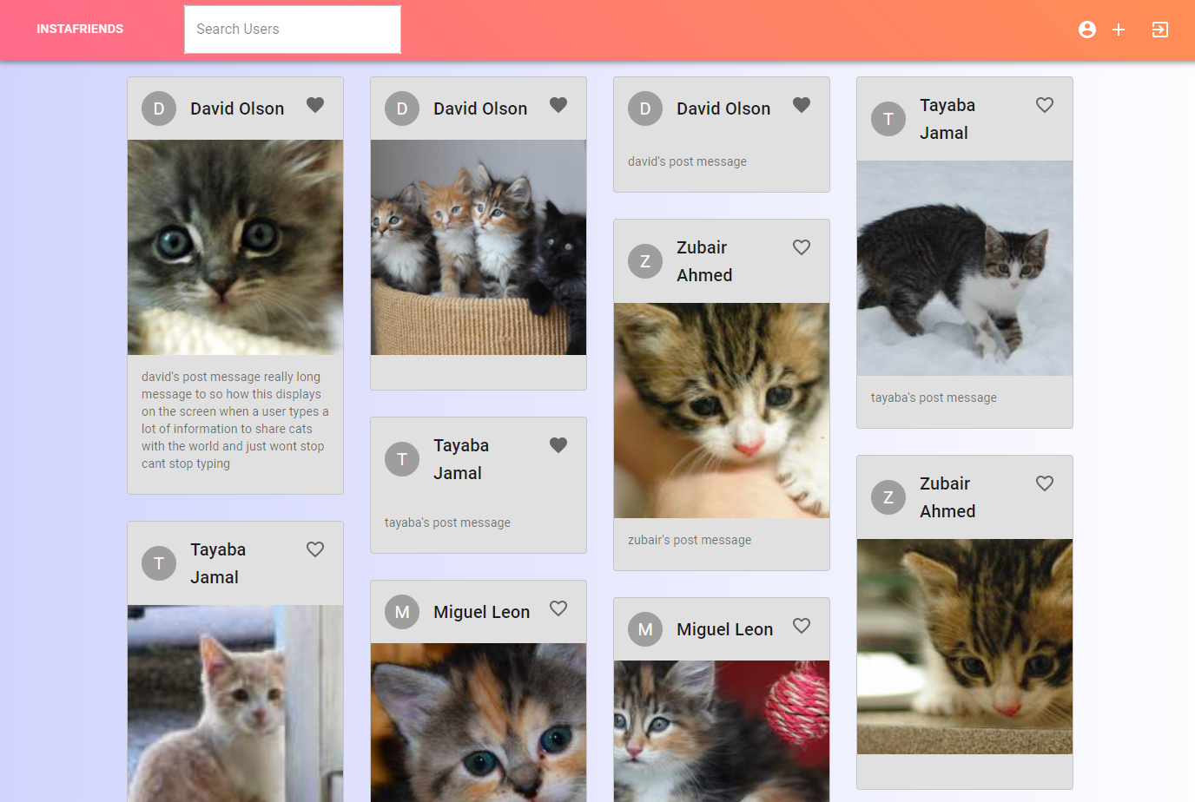
Interact with others on the platform by...
- Liking posts
- Reading post captions
-Creating new posts
- Searching for fellow cat lovers

Slide 7
Safety and security Just as cats love their privacy... WE DO TOO
We at INSTAFRIENDS understand the importance of users being able to securely access their accounts AND safely logout
This is enacted through our integration of Hashing passwords through encryption technologies and frequent session validation

Slide 8




Technologies used
Spring MVC
Spring ORM
React JS
Redux
Hibernate
AWS S3 Image Storage

Slide 9
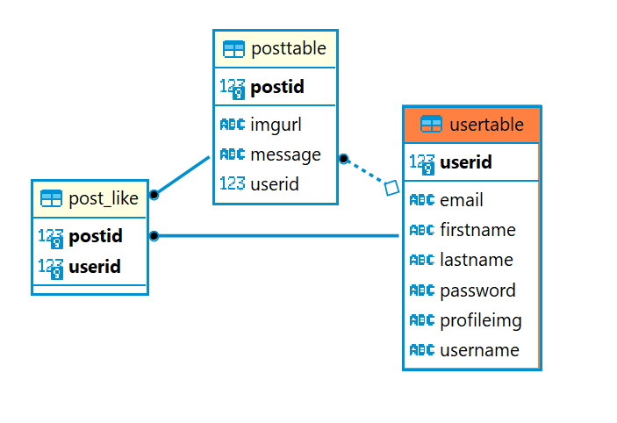
Our database schema

Slide 10
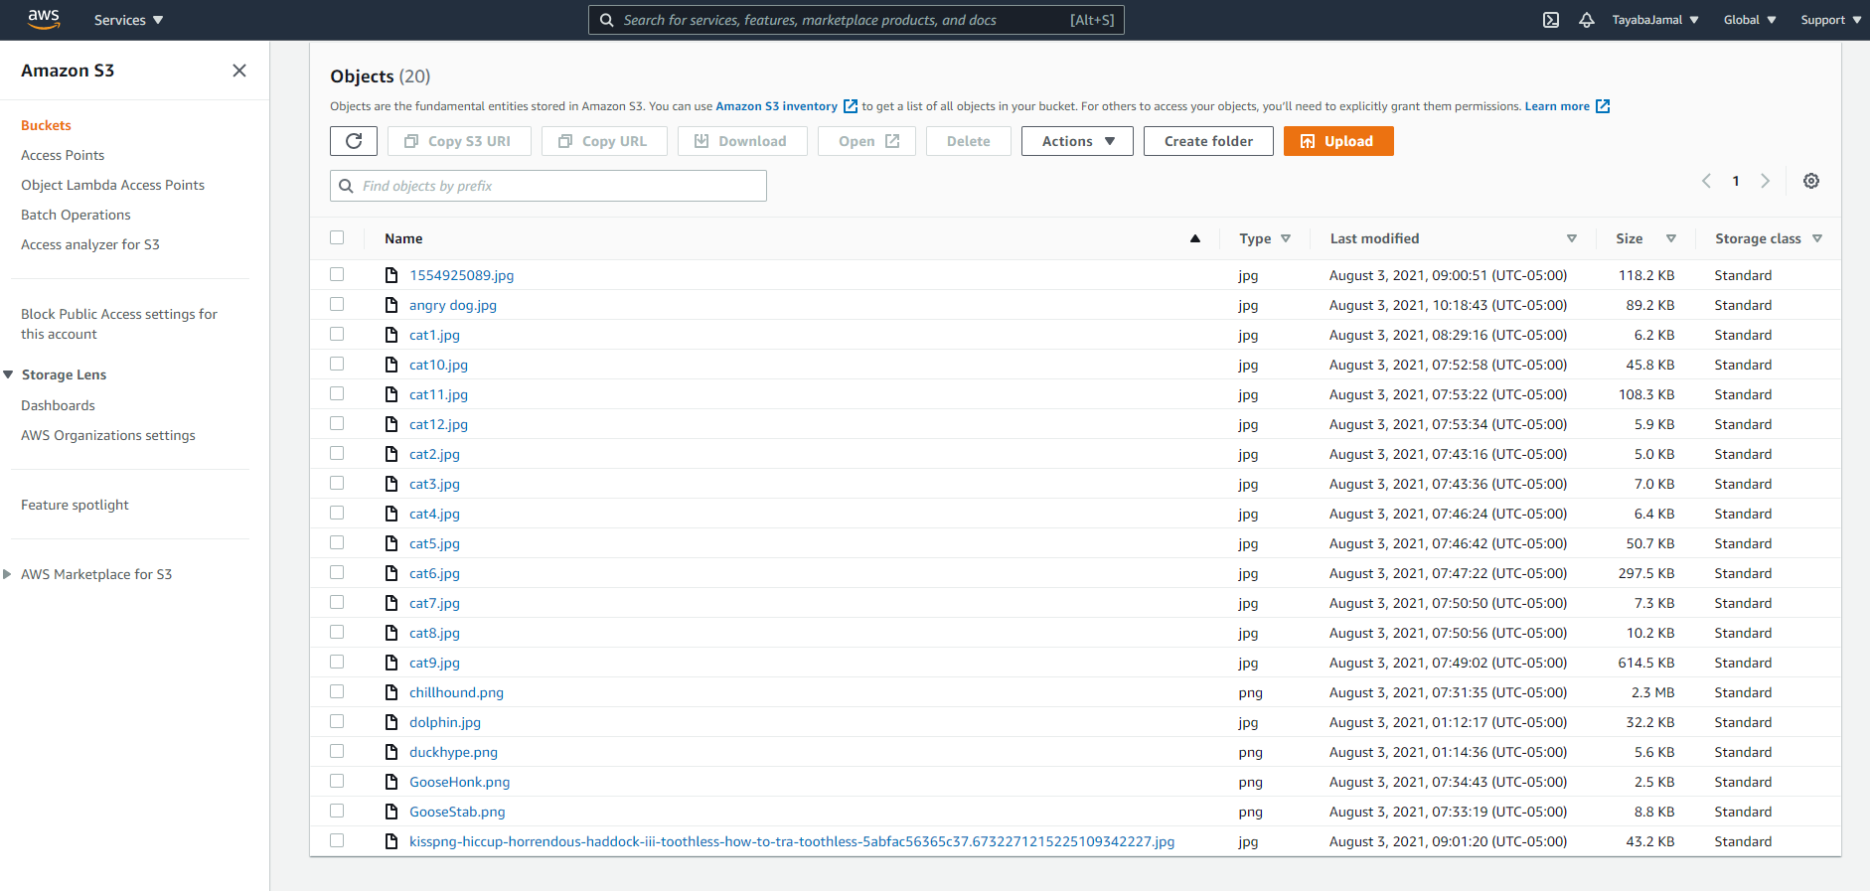
AWS S3 bucket

Slide 11
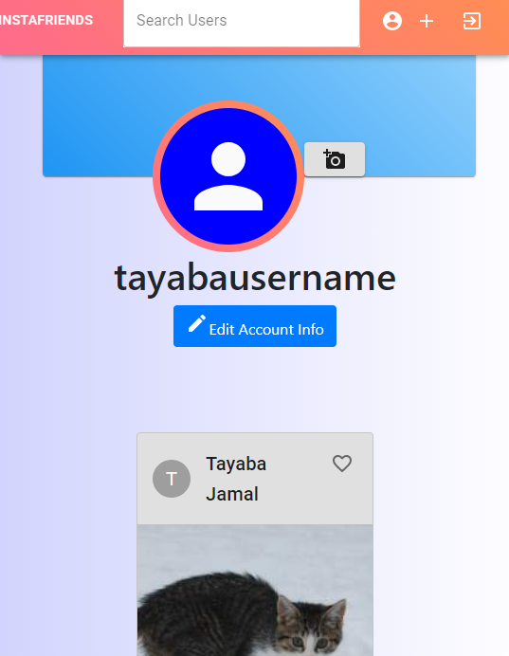
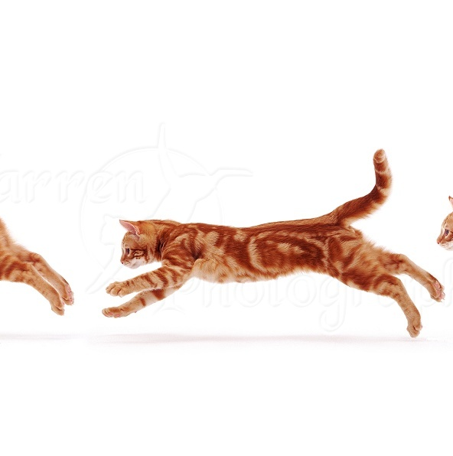
Cats on the go!!
Mobile View Capability

Slide 12
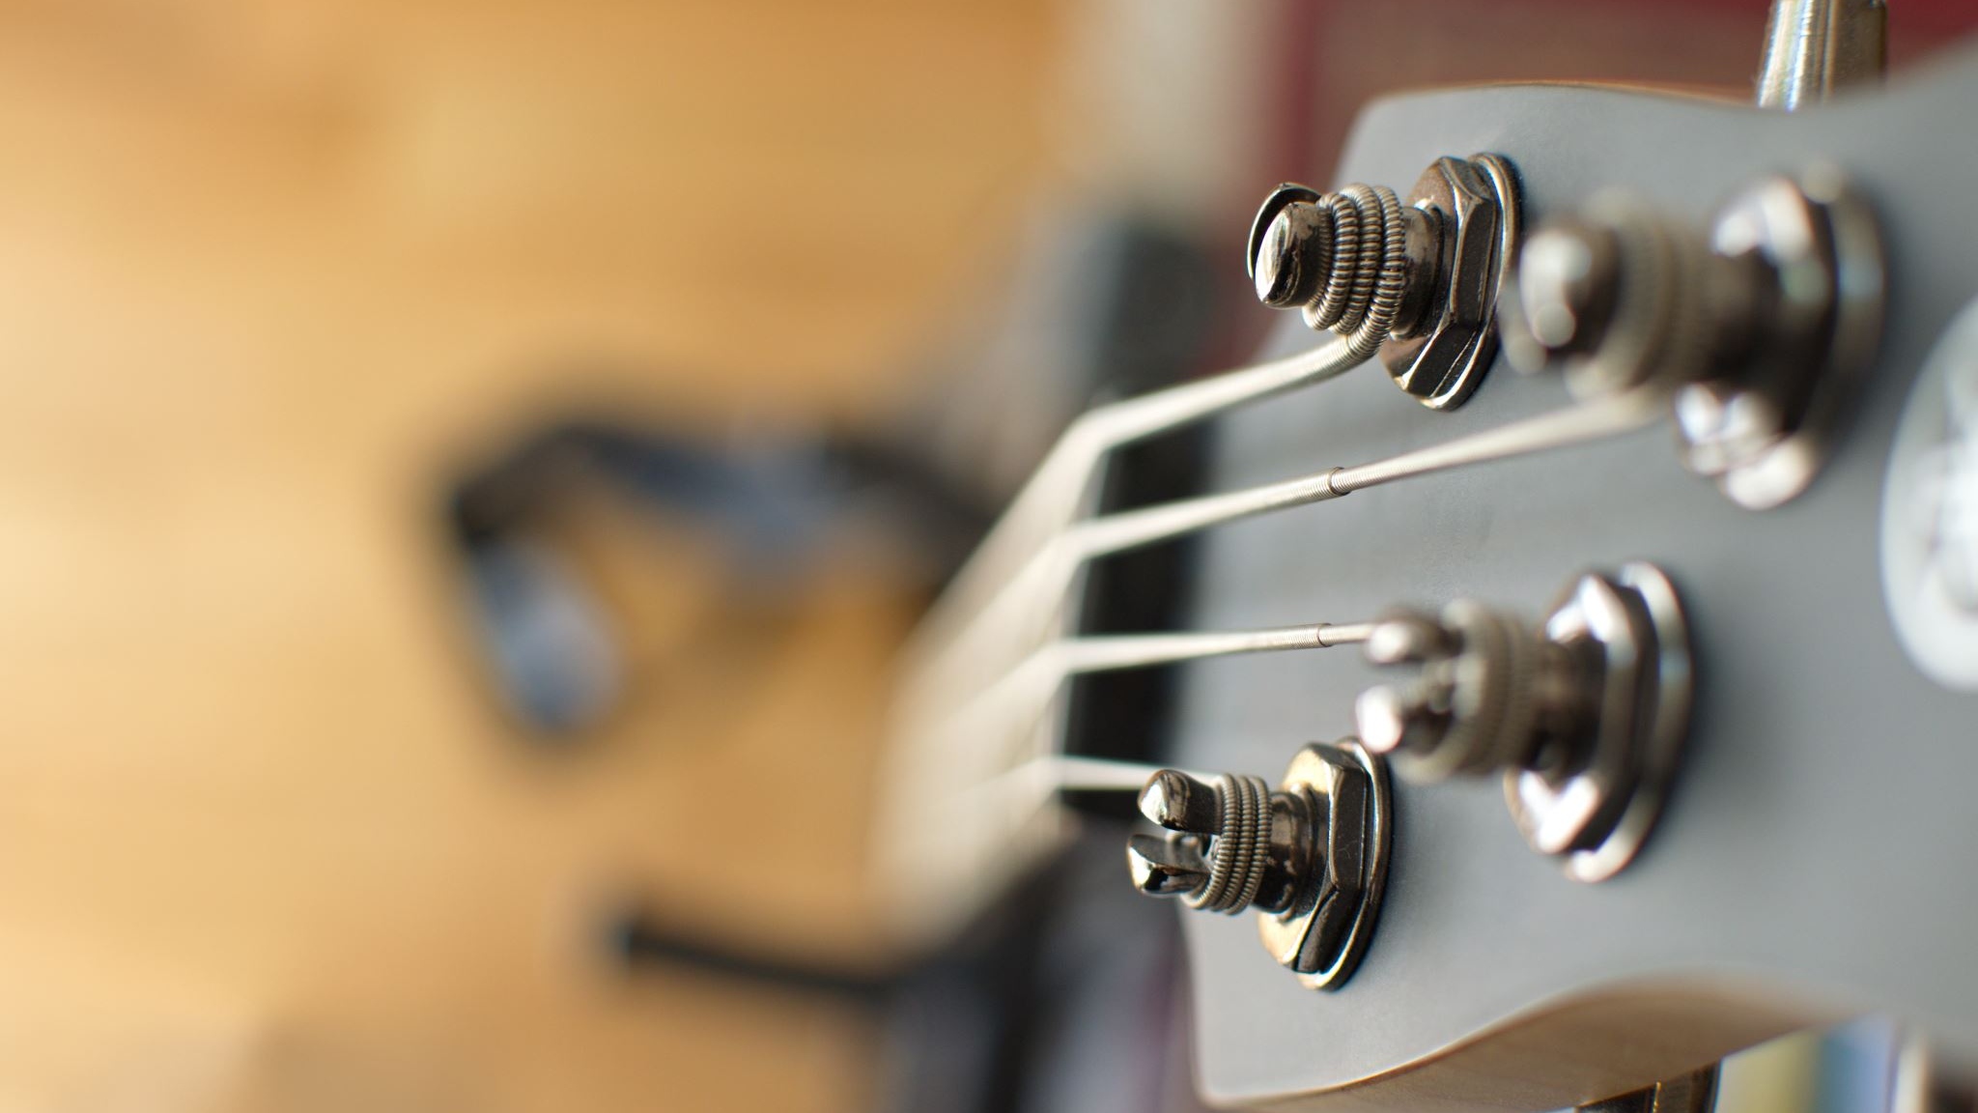
Now for the DEMO

Slide 13
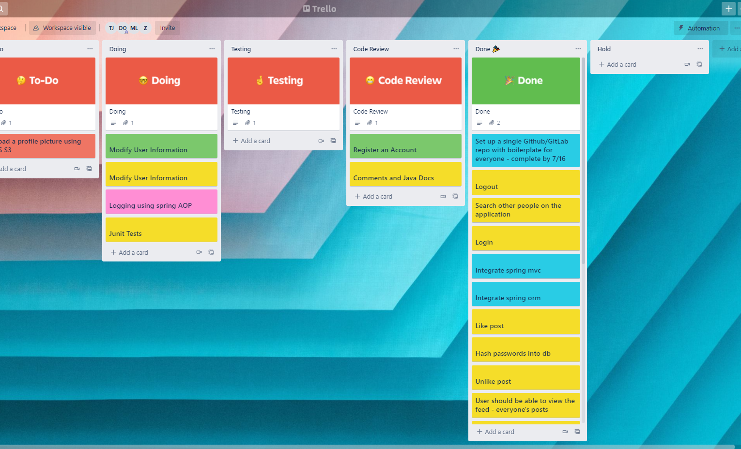
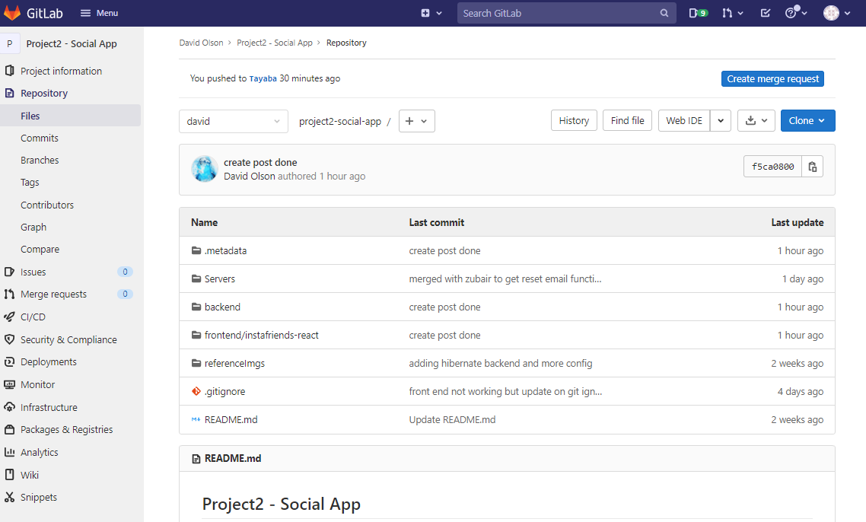
Project management tools used
- Kanban was utilized for delegating tasks to each group member

Slide 14
Challenges and setbacks Future Updates
- Collaboration through the git repository proved to be challenging for team productivity
----------------------------------
- Leaving comments under posts
- Add users to "favorites/best friends" list

